Slide 1

FRAUD REVIEW DETECTION WEB APP – FINAL PRESENTATION
ANANTHAKRISHNAN JAYADEV (100886199)
ATHUL KUNNIL VINAYAN (100936894)
BIBINDAS KIZHAKKE KAMMIL (100940754)
ROOPESH NAIR PERAYIL (100858755)

Slide 2
Project Definition and overview.
AIM: to develop a real-time Fraud Product Review Detection application for products on Amazon.
WHY? By detecting and filtering out fraudulent product reviews, it ensures that customers receive accurate and unbiased information, leading to improved consumer confidence, and reduced reputational risks
WHY NOW: Due to the increase in online purchases and the rise in concerns about review manipulation and the need for a transparent and trustworthy online shopping experience.
APPROACH: Implement a combination of NLP analysis, machine learning models, and real-time monitoring to identify and filter out suspicious reviews.

Slide 3
Project Stages.
Project Plan
Data collection
Data pre-processing
Model Development
Web App design
Integration
Testing and evaluation
Deployment
Maintenance and support

Slide 4








Application

Slide 5
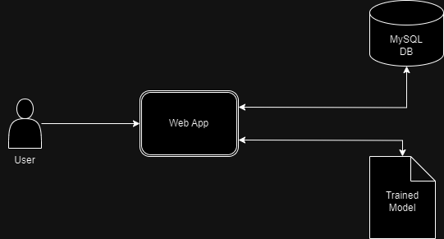
PROJECT ARCHITECTURE

Slide 6
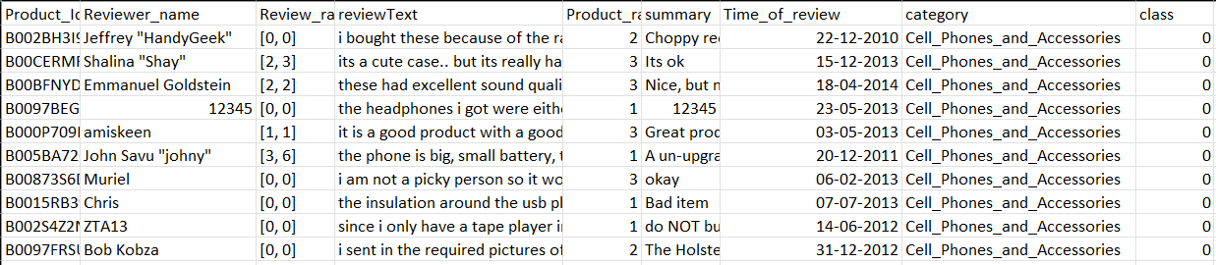
DATA DESCRIPTION
The data was collected from https://www.kaggle.com/code/lazargugleta/amazon-review-spam-detection-ml-dl/input
The dataset has 9 million datapoints

Slide 7
Frontend Functionality
Functionalities
User registration
User login
Page for pasting the review & get the result
Feedback Page
User action history

Slide 8
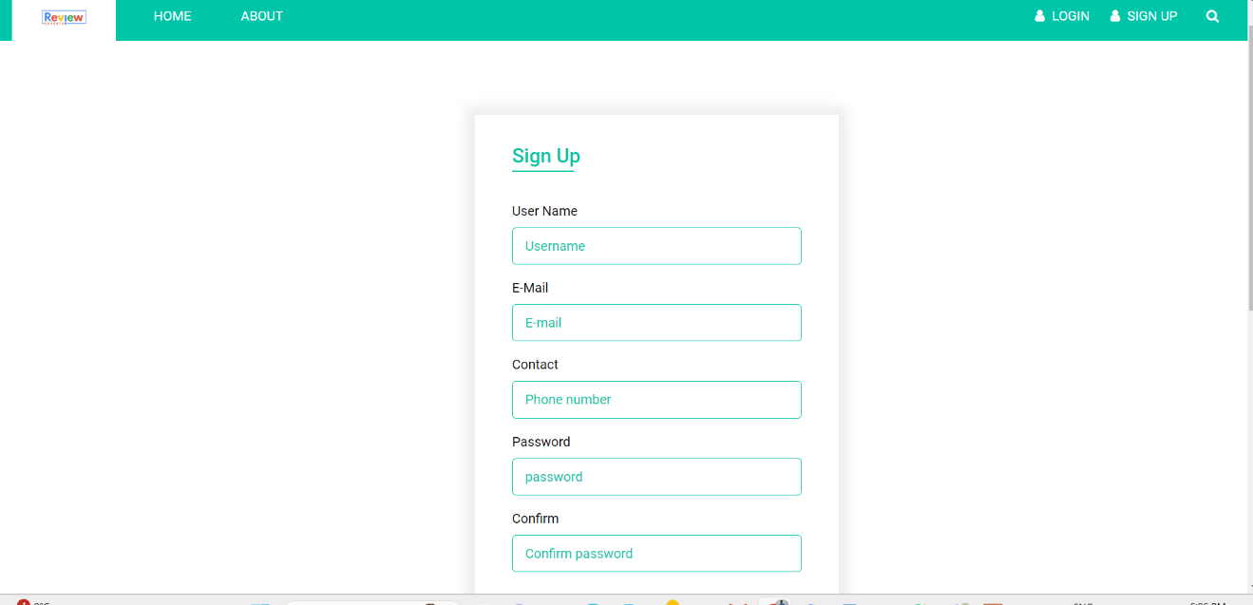
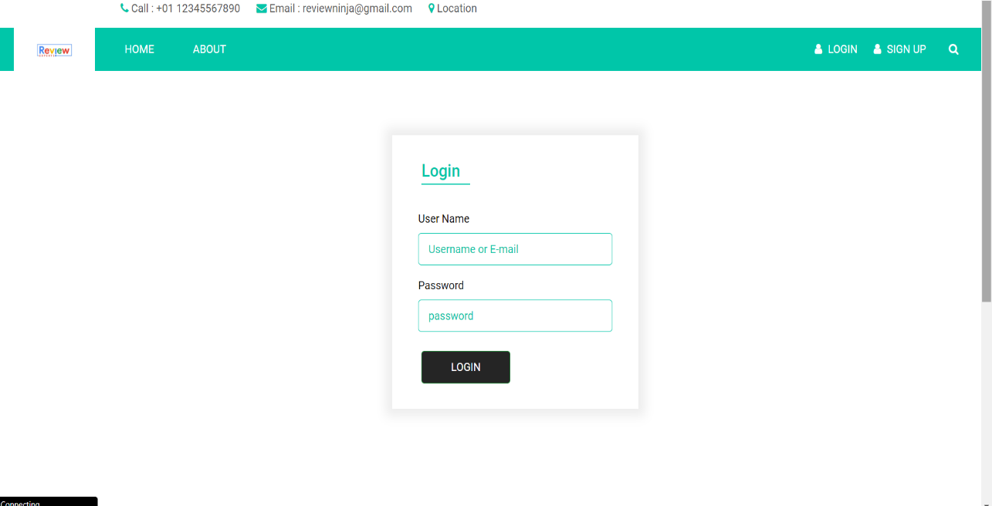
UI screenshots

Slide 9
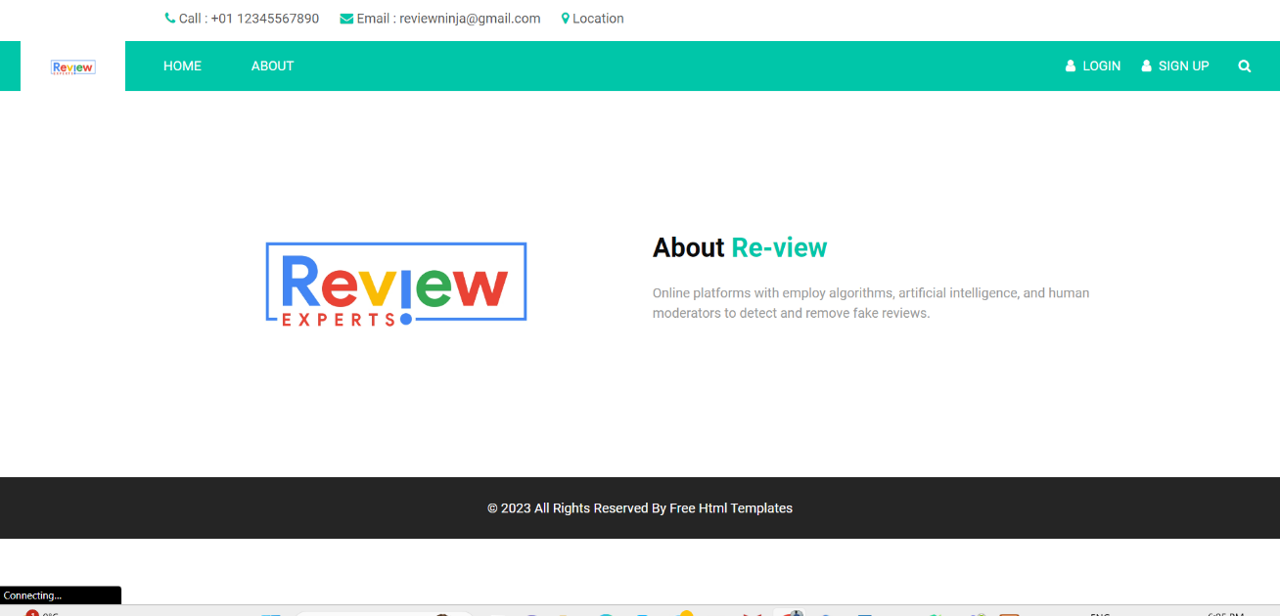
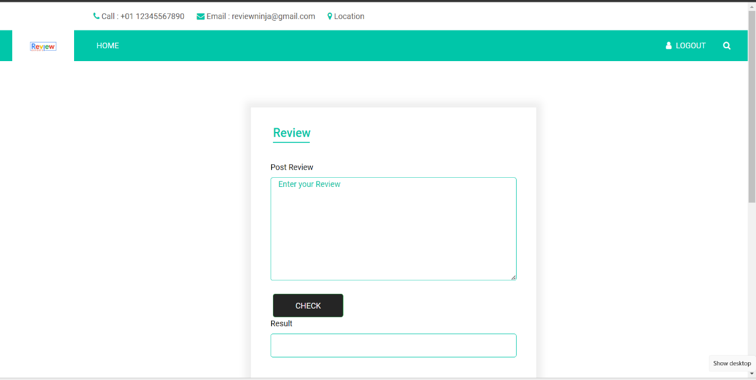
UI screenshots

Slide 10
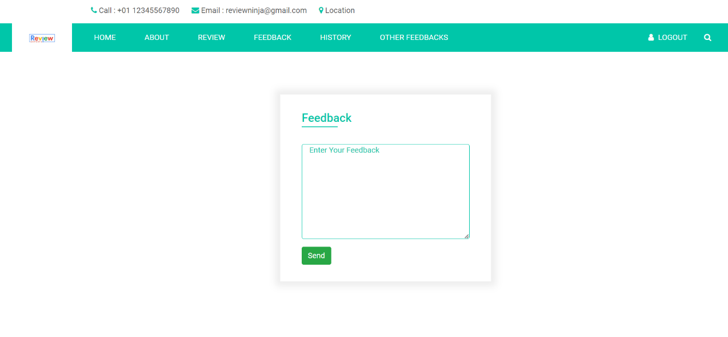
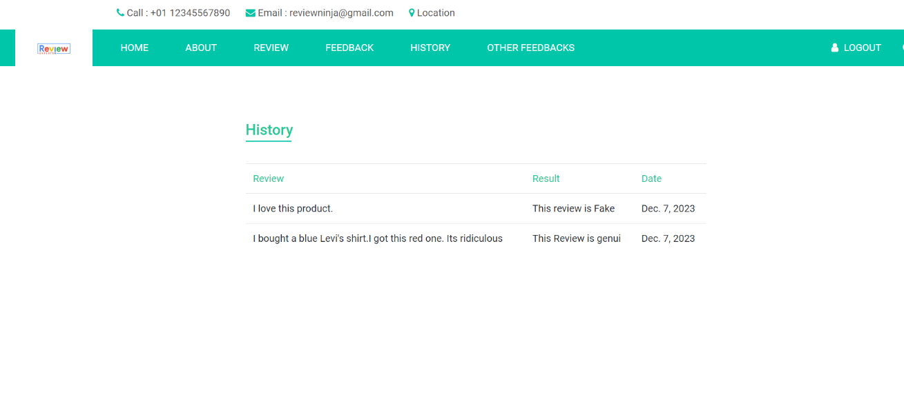
UI screenshots

Slide 11
Backend Functionality.
Functionalities
Registering user details to DB
Authenticate login operation
Natural Language Processing on review text data.
Develop and deploy ML/DL model using the amazon review dataset (supervised learning).
Use Ml/DL models to predict whether the real-time review text is fake or not
APIs to take the review text from front end and send the result value to the front end.
Deployment of optimized ML model

Slide 12
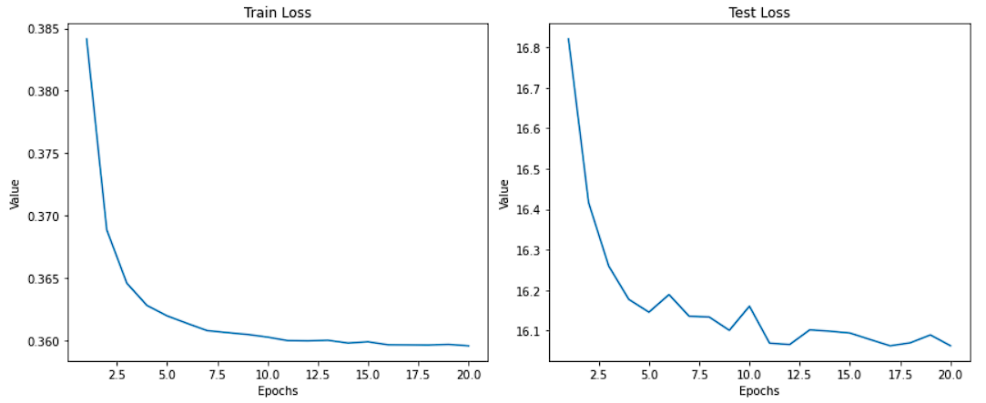
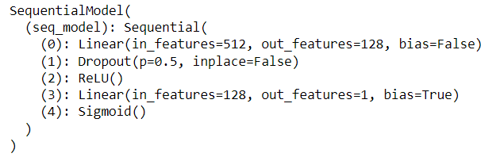
Optimized Model:
We selected the Sequential NN Model as the final model
Text Data is encoded used TFIDF and then passed to SNN model

Slide 13
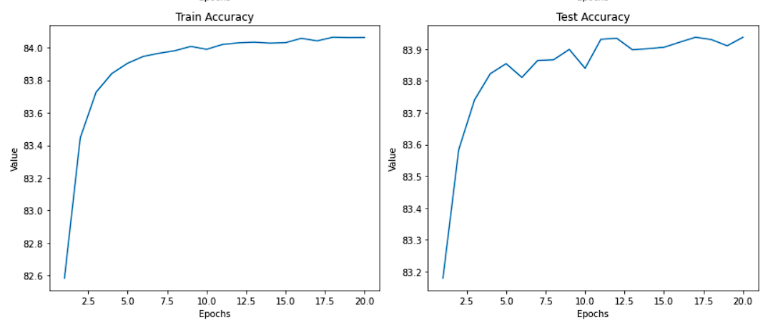
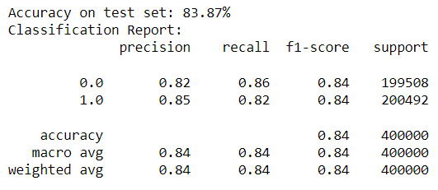
Optimized Model:

Slide 14
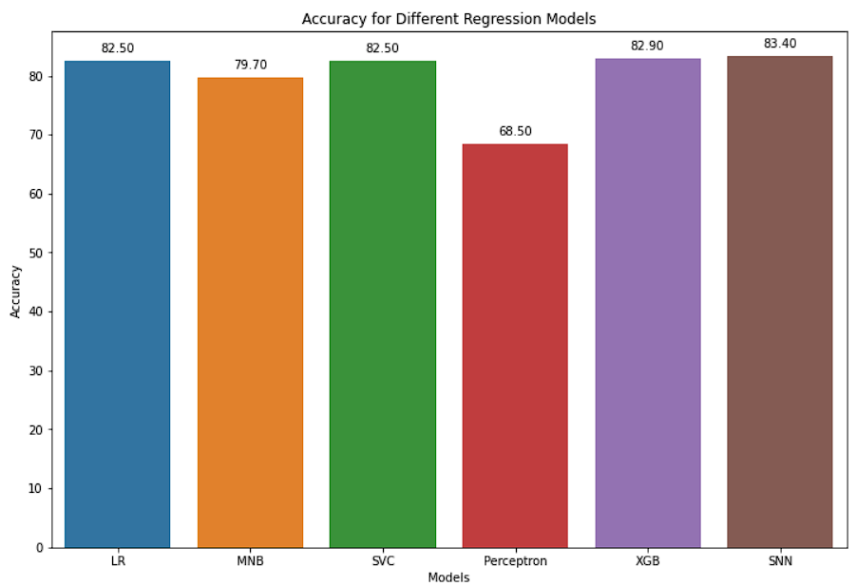
Optimized Model:

Slide 15
Thank you

